Slide 1
Western Virginia
Continuum of Care
General Meeting
January 11th, 2024: 10am-12pm
Woodstock, VA
Notes:
10am (DAVID)

Slide 2
9:30 – 10:00 AM: Open Networking
10:00 AM: Welcome and Introductions
10:15 – 10:45 AM: Eviction law information session:
Overview on eviction laws & legal issues around housing & landlord-tenants’ rights & responsibilities
11 AM: 2024 PIT Count Planning
11:10 AM: CoC VHSP & HMIS MOUs
11:15 AM: CoC VHSP Funding Opportunity
11:30 AM: CoC Committee Updates
AGENDA
Notes:
10-10:05 (DAVID)

Slide 3
A “Continuum of Care” (CoC) is a regional or local planning body that coordinates housing services and provides funding.
The Western Virginia Continuum of Care (VA-513) is a network of agencies and individuals working together to build a system of care for families and individuals who are experiencing homelessness in the Shenandoah Valley.
Goal: Homelessness is rare, brief, and non-recurring.
Vision: Everyone has a safe and stable home.
WHAT IS A CoC?
Notes:
CoCs are expected to address homelessness through a coordinated community-based process of identifying needs and building integrated systems of housing and services that meet those needs.
CoCs are governed by HUD.
Our CoC is a network of community organizations working together to make homelessness rare, brief, and non-recurring.

Slide 4
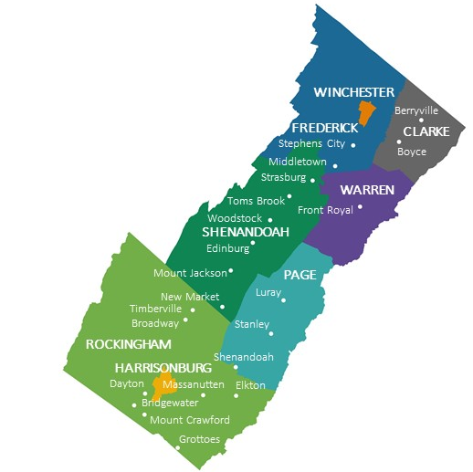
Western Virginia CoC (VA-513) Geographic Area
OVERVIEW
Notes:
The Western CoC covers an area of over 2400, sq. miles of the Shenandoah Valley, from Frederick County in the north to Rockingham County in the south.
It was formed in 2012 by the merger of the Harrisonburg-Rockingham CoC with the Northern Shenandoah Valley CoC .

Slide 5
Centralized Intake
Street Outreach
Housing Services
Centralized intake & Street outreach: work concurrently to connect individuals to housing services
Rapid Rehousing: Limited to literally homeless
Homeless Prevention: targeted assistance for individuals at risk of homelessness
Permanent Supportive Housing: Limited to literally homeless diagnosed with disability and substance use disorder and persons diagnosed with HIV/AIDS.
Tenant Based Rental Assistance: Ongoing rental subsidies similar to housing voucher
Emergency Shelter & Domestic Violence Shelter
Supportive Services
Case Management, Housing Stability financial assistance (including move-in assistance), referrals, outreach, consultation, mental health, developmental disability, food distribution.
Independent living skills & Skills building, employment, counseling, medication, transportation, crisis stabilization, substance abuse, veteran & family support, youth mentoring & education, safety planning, etc.
SERVICES
Permanent Supportive Housing
Prevention
Rapid Rehousing
Housing Opportunities for People with AIDS
Emergency Shelter
Built for Zero
Notes:
Supportive Services are an integral part of all of these housing services. This includes case management, referrals, consultation, food distributions, skills building, employment counseling, medication and transportation support, crisis stabilization, veteran and family support, youth mentoring and education, and much more.

Slide 6
Information Session
Overview on eviction laws & legal issues around housing & landlord-tenants’ rights & responsibilities
Elizabeth Coltrane – Staff Attorney
Q&A: 10:45 – 11:00 AM

Slide 7
WHY
Count total number of people experiencing homelessness in our region (not just the number of people receiving our services)
Required by HUD, used to allocate state and federal funding
Learn more about who is experiencing homelessness and why
HOW
Count everyone staying in all types of shelters
Conduct interviews at central locations
Engage street outreach to encampments/popular locations
30+ volunteers
PIT COUNT 2024

Slide 8
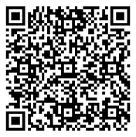
GET INVOLVED
Sign up to volunteer :
https://forms.gle/BQZC1dp9Mrt3MYbF7
2. Attend a Zoom Training for volunteers:
January 18th, 3-5pm OR January 22nd, 1-3pm
3. Participate in the PIT Count
January 24-25, 2024
PIT COUNT 2024

Slide 9
Programming Continuity – Northern Region
ARE exiting CoC’s VHSP collaborative funding
CoC is issuing a NOI to solicit new projects in the North
RRH & Prevention: Winchester, Clarke, and Warren
Street Outreach: CoC-wide coverage
CoC Partnerships Agreements
VHSP & HMIS MOUs: Revision to include: updated CoC logo, timeline and procedure for termination
System performance Measures: explore ways to best engage and leverage agencies’ work to improve system performance
Account for unique regional and agencies circumstances
Use this process to build regional capacity and address local needs
Incorporation of Lived-Experience expertise in project design & strategic planning - Ongoing
IMMEDIATE PRIORITIES
Notes:
ARE: Strategic decision to realign programming with organization mission, focus on community healthcare. Organization will to provide HOPWA services
NOI to be sent by January 16th. Selection conclusion by Ad-hoc committee-Feb 2nd
CoC Partnership Agreement: work toward greater cohesion
SPMs: Account for local specificities: practical ex. Set separate SPM goals for each region based on housing and services available
Incorporation of lived expertise:
Be intentional and purposeful about including PWLE at all table, allowing them to be at the forefront of the whole process
CoC stood up a LEAC last year, with set aside funds to reward their contribution to the CoC.
Best practice is to engage consumers in all levels of system planning.

Slide 10
SPMs Guiding Questions
Is the program effective?
What difference did it make in the community?
Do our outcomes differ across different sites?
What is working well/not working well with our services?
Was it worth it given the overall time and resources invested?
Importance of Outcome Evaluation
Only way to improve outcomes
Outcomes: Change statement. Expectation as result of program activities
Best way to provide targeted capacity building and address local needs.
Notes:
Outcomes: benefits or changes as result of program’s activities. It answers the following questions:

Slide 11
FY 2024-2026 VHSP Application Process - Overview
RFP Release: Expected by 1st Week of February
All-grantee meeting: Within a week after RFP release
DHCD “How to Apply Webinar” - TBD
Grant writing team designation:
Initial Draft proposal – Week of March 4th
2nd All-Grantee Meeting – include budget reconciliation: March 11th
Final draft completion: March 25th
Proposal submission deadline: Late March – April 1st – CoC to work on early submission – by March 29th

Slide 12
Committee Updates
Best Practices
Vacant Deputy Chair Position
Media & Advocacy
Executive Committee
Data & Performance
Compliance & Evaluation
Work Groups & Advisory Committees
Centralized Intake
Lived Experience Advisory Committee

Slide 13
FY 2024 CoC General Meeting Schedule
January 11, 2024: Woodstock
February 8, 2024: Woodstock
February 15, 2024 VHSP Info Session – Virtual
April 11, 2024: Winchester
June 6, 2024: HUD NOFO Info Session - Virtual
June 13, 2024: Harrisonburg
August 8, 2024: Winchester
October 10, 2024: Harrisonburg

Slide 14
Western Virginia
Continuum of Care
Next Meeting
February 8th 2024
Woodstock, VA
Kaitlin Heatwole David Mutombo
HMIS Administrator CoC Coordinator
kheatwole@harrisonburgrha.com dmutombo@harrisonburgrha.com
Notes:
11:55-12

